Slide 1

Statistics and Posters

Slide 2
Topic of today’s lecture
A bit more on statistics
+
Posters
Reading for this lecture (and last lecture):
Research Methods in Psychology
Chapter 10, Chapter 11 (Section 57 only).

Slide 3
Last week, this week
Within-subjects comparison between two conditions
Sign test
Between-subjects comparison between two groups
Mann-Whitney test
Correlation between two variables
Significance of a Pearson correlation co-efficient

Slide 4
An example using a between-participant design.
In this example, we have Test A and Test B taken by different people, so we can’t look at the direction of a difference for each person.
So, we start with a different assumption.
If Test A and B are (roughly) the same then the highest (vs lowest) scores should be spread out equally across both conditions.

Slide 5
The case with 4 participants.
We have 1 score per person (with half the sample doing each test).
Score Condition
Person 1 10 A
Person 2 5 B
Person 3 8 A
Person 4 4 B
Here the two HIGHEST scores are in A, and the two LOWEST scores are in B.
What is the probability that this happened by chance?

Slide 6
For our simple example, there are 24 possible rank orders (of Person 1, 2, 3 and 4).
1st 2nd 3rd 4th
1 1 2 3 4
2 1 2 4 3
3 1 3 2 4
4 1 3 4 2
5 1 4 2 3
6 1 4 3 2
7 2 1 3 4
8 2 1 4 3
9 2 3 1 4
10 2 3 4 1
11 2 4 1 3
12 2 4 3 1
1st 2nd 3rd 4th
13 3 1 2 4
14 3 1 4 2
15 3 2 1 4
16 3 2 4 1
17 3 4 1 2
18 3 4 2 1
19 4 1 2 3
20 4 1 3 2
21 4 2 1 3
22 4 2 3 1
23 4 3 1 2
24 4 3 2 1

Slide 7
How many of these have Person 1 and 2 in the highest rank positions?
1st 2nd 3rd 4th
1 1 2 3 4
2 1 2 4 3
3 1 3 2 4
4 1 3 4 2
5 1 4 2 3
6 1 4 3 2
7 2 1 3 4
8 2 1 4 3
9 2 3 1 4
10 2 3 4 1
11 2 4 1 3
12 2 4 3 1
1st 2nd 3rd 4th
13 3 1 2 4
14 3 1 4 2
15 3 2 1 4
16 3 2 4 1
17 3 4 1 2
18 3 4 2 1
19 4 1 2 3
20 4 1 3 2
21 4 2 1 3
22 4 2 3 1
23 4 3 1 2
24 4 3 2 1
i.e. By chance we would expect Person 1 and 2 to be the highest 2 scoring people 4 times out of 24 = 16.7% of the time.

Slide 8
This too can be extended
For any set of scores, we can calculate the probability that any rank order would be generated by chance, and then check the probability of that distribution of rank orders across our conditions.
In this example, the highest score is 16, which gets a rank of 1, the next highest score is 14, which gets a rank of 2, and so on down to 2, which gets a rank of 8.
We see that 3 out of 4 top scores are for Test A, and 3 of the 4 lowest scores are for Test B.

Slide 9
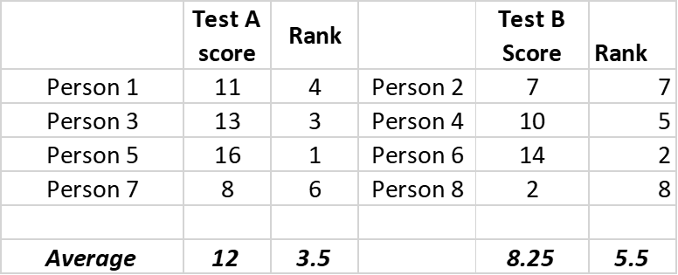
This is the Mann-Whitney (or rank-sum) test
Fortunately, you don’t have to calculate the probabilities by hand. This can be done with statistics packages, or Excel.
Notice however, that because we are looking at RANK ORDER of the scores, we are not basing our statistical test on the SIZE of the difference.
Like the Sign test, this statistical test tells us about the distribution of scores, not their means.

Slide 10
The conclusions depend upon the assumptions!
Scenario 1
Scenario 2
Just as with the Sign-Test, we can get situations where the rank-orders may not reflect the direction of the means. See the two examples above. They have the same rank orders, but the means show opposite patterns.
And, just as with the Sign test, our statistical analysis tells us about the distribution of scores, not their absolute size (i.e. which test gives the highest average).

Slide 11
If your group projects involve a comparison of scores across two conditions:
For within-subjects designs (participants do both conditions) you should use a Sign Test.
For between-participant designs (participants do one condition only) you should use the Mann-Whitney test.
In both cases, the test will tell you the likelihood of observing the distribution of scores that you obtained. It will not tell you about the size of the difference between the averages.

Slide 12
Assumptions behind statistical tests
Both the Sign-test, and the Mann-Whitney test which condition tends to be associated with the highest scores.
They make no assumptions about the size of the differences, or how these data are distributed.
i.e. they only require that the data can be placed in a rank-order: i.e. ORDINAL data only.
(They can also be used for interval and ratio data, but not categorical data).

Slide 13
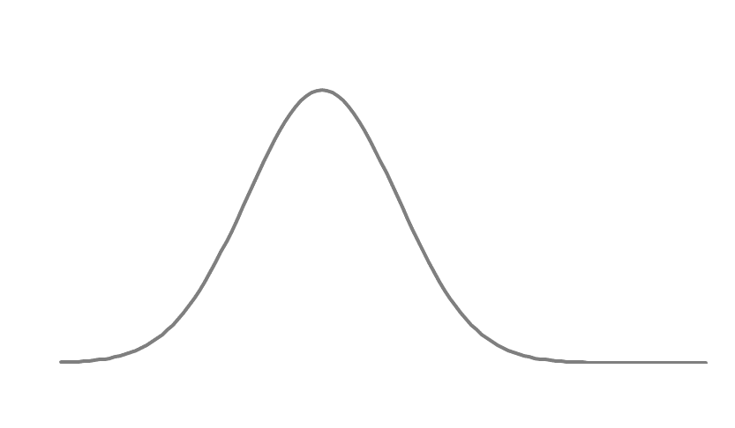
Non-Parametric vs Parametric tests
Statistical Tests that make no assumptions about the distribution of likely scores are called Non-parametric.
Other (more powerful) statistical tests rest upon assumptions about the underlying distribution of scores. These distributions (like the bell curve) can be described by mathematical parameters, and so these are called Parametric tests.
The larger the sample size, so the closer the distribution of coin-flips resembles a normal distribution (bell-curve). This is called Central Limit Theorem.
TTHH
THTH
THHH THHT HTTT
HTHH HTTH THTT
HHTH HTHT TTHT
HHHH HHHT HHTT TTHH TTTT

Slide 14
The significance test for Pearson’s r…
…is an example of a parametric test.
It assumes that the data are normally distributed (come from a bell curve).

Slide 15
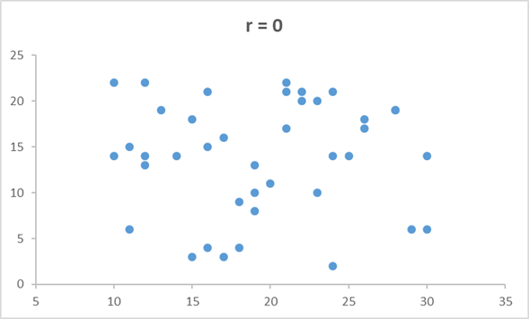
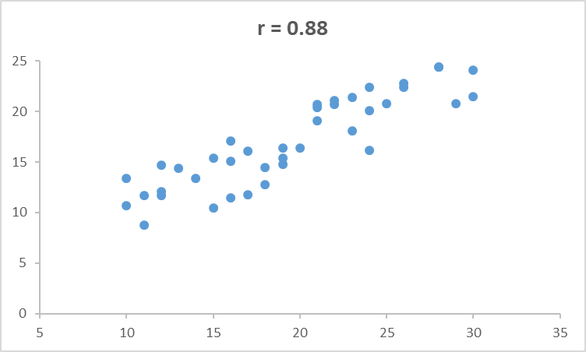
Analysis of correlational data for your project
For any two variables, we can ask how much association we would expect to see between them by chance.

Slide 16
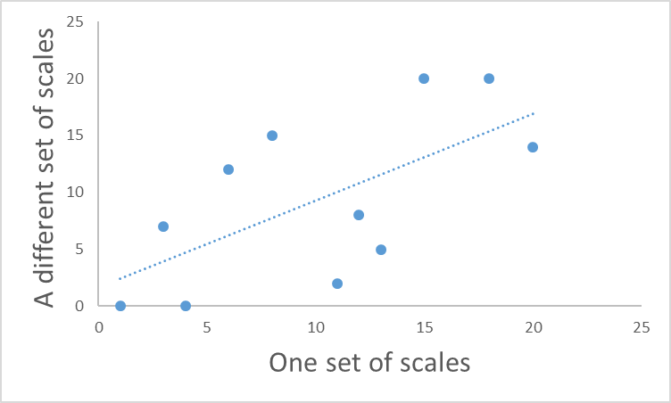
For any scatterplot
By chance, we would expect the points to be randomly scattered across the graph (with no obvious pattern).
However, randomly, we might observe a degree of correlation.
As with our tests for differences across groups, we can ask how likely our observed pattern is if the relationship was just chance (i.e. given the null hypothesis).
And, as with our previous examples, we set a criterion (5%) for accepting that our outcome was unlikely by chance.

Slide 17
Doing the statistical analysis for your project
Data scientists use software for analysis
80%+ of professional data scientists use R.
As a teaching tool, we’ll use an Excel spreadsheet.
For your poster, you should include the necessary statistics, and (for the assessment) be able to explain what they mean.

Slide 18
Sample size, power, and significance
The importance of sample size…

Slide 19
Remember this: 4 coin flips
TTHH
THTH
THHH THHT HTTT
HTHH HTTH THTT
HHTH HTHT TTHT
HHHH HHHT HHTT TTTH TTTT
The chance of 4 Tails in a row is 1/16, or 6.25%.

Slide 20
Extending this to 5 vs 8 coin flips:

Slide 21
5 vs 8 coin flips:
For 8 flips, ONLY 7 have to be Tails to be significant
For 5 flips, ALL of them have to be Tails to be significant

Slide 22
Sample size and significance
For a sample size of 5, 5% significance is reached if 5/5 (= 100%) of trials show a TAIL.
For a sample size of 8, 5% significance is reached if 7/8 (=87.5%) of trials show a TAIL.
For a sample size of 12, 5% significance is reached if 9/12 (=75%) of trials show a TAIL.
Etc
i.e. larger sample sizes require less extreme differences (i.e. smaller effects) in order to show a significant difference.

Slide 23
Sample size and Power
Put another way, for any given size of effect, larger samples give you a greater likelihood of detecting it (if it exists).
i.e. if a coin is slightly biased (e.g. comes up Tails 60% of the time), you are more likely to detect this effect, the larger the sample you have.
The Power of a statistical test is the likelihood it will detect an effect of a given size (i.e. find a significant difference) if the effect really exists.

Slide 24
Sample size, effect size, significance
Sample size
Bigger sample sizes:
Enable the detection of smaller effect sizes.
For a given effect size, give lower estimates of probability by chance
Statistical Significance
Effect size

Slide 25
Sample size, effect size, significance
Sample size
Statistical Significance
Effect size
Bigger effect sizes:
For a given sample size, will lead to lower estimates occurrence by chance
For a given significance level, require a smaller sample to detect.

Slide 26
Significance vs practical importance
Sample size
For very large samples, very small differences (or correlations) can be statistically significant; these (may) be of no practical value.
Larger samples are more able to detect smaller effects
Statistical Significance
Effect size

Slide 27
Part 2: Posters
3 topics to cover:
1: What your poster should contain
2: What your poster should look like.
3: How do you make a poster? (covered in Workshops)

Slide 28
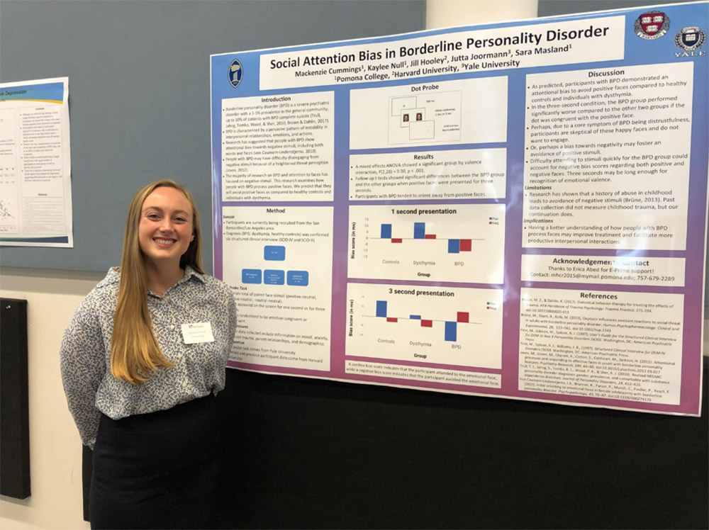
A scientific poster is…
A visual display of a science project for other scientists
Presented in a poster session during a conference
Supported by Q&A with the authors

Slide 29
The authors are expected to
Give a verbal summary of all aspects of the research
Answer specific questions (particularly about details not on the poster)
(You will do this as a GROUP).

Slide 30
A poster should be…
Engaging
Informative
Structured
Scientific
All for the benefit of a scientific audience
Achieved through
Aesthetics (visual appeal)
+
Scientific content
Backed up by authors in Q & A session

Slide 31
Part 1: The formal elements of a Poster
1: A title (visible from 3-4 metres)
- with a list of authors
2: Introduction
3: Method
4: Results
5: Discussion

Slide 32
The Title (and authorship)
Is the primary way to engage a potential audience.
It should be engaging and informative.
It should be visually appealing from a distance.
It should be accompanied by the list of authors.

Slide 33
For your poster: The Title (and authorship)
Your title should try to engage a scientific audience.
It should be informative:
i.e. NOT “Our group study”.
It should make the audience want to learn more
“A study of exercise and memory”
vs
“Does exercise boost memory performance?”
vs
“Can you jog your memory?”

Slide 34
For your poster: The Title (and authorship)
Your Title should appear at the top of your poster, large (and distinct enough) to be seen from about 3-4 metres.
A full list of authors (first name and surname) should appear beneath the poster.

Slide 35
Introduction
After reading your introduction the audience / reader should understand:
What is already known about the topic (i.e. the background literature).
How your study follows on from, or adds to, this knowledge.
What you plan to do.
What you expect to find (your hypothesis).

Slide 36
For your poster: Introduction
Around 100-200 words of text covering the following:
1) An opening section introducing the broad topic
2) Give some relevant background by provide details of at least 2 or 3 previous studies.
For each one, provide an answer to these two questions:
a) What did they do?
b) What did they find?
Notice that I didn’t say anything about what the authors “said” or “claimed”

Slide 37
For your poster Introduction (continued)
3) On the basis of this background, how does your study link to, or add to this knowledge?
What is your study going to do?
What do you predict in your study?
(Don’t write out the null hypothesis).

Slide 38
Method
This has 3 key elements
Participants
Give a description of your sample, and how you recruited them.
Materials
Explain what materials you used (e.g. questionnaires, diaries etc.) and where they came from (if they are existing measures).
3) A description of the procedure you used.
Give a description of what happened during your experiment, and what data you collected.

Slide 39
For your poster Method
1) A Participant section detailing your sample (how many, any demographic information?)
2) (If necessary) a materials section detailing any existing scales / measures you have used.

Slide 40
For your poster: Method (continued)
3) A procedure section detailing how the study was run so that a reasonable person could replicate it if necessary.
This should include the details that make a difference to the outcome (that a person would reasonably need to know).
The context the experiment took place in
The instructions given to participants
What the participants had to do
What data were collected

Slide 41
For your poster: Method (continued)
What do I mean by reasonable?
Nothing irrelevant or unimportant:
e.g. the colour ink in the pen used by the participant.
Nothing that a reasonable person would assume anyway.
e.g. that there was oxygen in the room.
But everything else that could reasonably make a difference to the outcome.
e.g. was there a time deadline?
what scale did participants use to rate their answers?

Slide 42
The Results
This has 2 or 3 elements per analysis
(If necessary) a description of how data were processed to obtain the scores that were analysed.
e.g. diary data on caffeine intake was averaged over 3 days.
Summary data (table, graph) showing the findings of your research.
e.g. the average caffeine intake in each condition.
The outcome of the statistical test carried out on the data.
e.g. the results of the Mann-Whitney rank-sum test on caffeine intake.

Slide 43
For your poster: Results
1: (If necessary) a description of how data were processed to obtain the scores that were analysed.
How were the data processed?
e.g. Scales totalled, response times averaged, errors counted…
How many participants excluded (and why)?
e.g. failed to follow instructions
gave up / took too long on task / withdrew

Slide 44
For your poster Results (continued)
Summary data (table, graph) showing the findings of your research.
e.g. the average caffeine intake in each condition.
For group differences show BOTH
The distribution of scores in each condition
The averages (means or medians) of the scores in each condition.
For correlational studies show BOTH
The distribution of scores on each measure
The scatterplot of the relationship between the measures.
Do this for each analysis you want to report.

Slide 45
Do this for each analysis you want to report.
It may be that you have data that will allow you to do more than one analysis.
E.g. Imagine you had a quasi-experimental design comparing Men vs Women on alcohol consumption over 2 days.
You could do a Mann-Whitney test to compare the Men vs Women on average alcohol consumption.
But you could also look at the correlation of alcohol consumption for Day 1 with Day 2. This would tell you if your measure of alcohol consumption is reliable.

Slide 46
Why do this?
If you find no difference between groups, then it could be:
That there is no difference to observe.
Your measure(s) are not reliable (and so not valid).
Examining whether your measure(s) are reliable (e.g. by correlating Day 1 with Day 2) provides evidence as to whether the second account is plausible.

Slide 47
Exactly the same applies to correlational designs
e.g. if you correlate a personality trait (e.g. extraversion) with a behaviour (e.g. alcohol intake) you could fail to find a reliable association because
That there is no difference to observe.
Your behavioural measure is not reliable (and so not valid).
Examining whether your measure(s) are reliable (e.g. by correlating Day 1 with Day 2) provides evidence as to whether the second account is plausible.

Slide 48
What other analyses might you want to do?
This is up to you, but you will have tested different participants, using different experimenters.
So, you might want to see if there are the same outcomes from different kinds of participants (e.g. psychology students vs others)
Or you might want to see if the different experimenters obtained the same general pattern of results.
Whether you choose to run this kind of analysis relates to the issues you raise in your Discussion.

Slide 49
3: The outcome of the statistical test.
For each analysis, you need to report 3 things.
The sample size used in the analysis.
n = ?
The name of the test and the and value generated:
Within-participant difference: The sign test (s =)
Between-participant difference: The Mann-Whitney (U=)
Correlation: The Pearson correlation coefficient (r =)
The significance of the result (i.e. how likely it occurred by chance). Either as
Exact value, e.g. p = .032
Less than 5%, e.g. p < .05.

Slide 50
The Discussion
This has 3 key elements
1: A summary of the main finding(s).
2: A section linking your findings to the prior literature.
3: A “what follows?” section

Slide 51
4: For your poster: Discussion.
1: Summarise the findings of all your analyses in English, without re-quoting the statistics. Make sure you accurately describe what you measured, and found.
e.g. Our study found that those who exercised more reported a higher level of consumption of healthy foods.
Notice here that I was careful to describe what was measured:
i.e. reported consumption of healthy foods. (not actual consumption)
And I described the direction of the difference.
i.e. higher consumption (not a different consumption)

Slide 52
4: For your poster: Discussion.
2: Link your findings to the prior literature.
e.g. did you find the same as different studies?
Which studies did you support / not support?

Slide 53
4: For your poster: Discussion.
3: What follows?
Critically evaluate your study?
What could be improved /done differently?
What could explain why you didn’t get the results expected?
What research could follow up your study?
What are the theoretical or applied issues that arise from your findings?

Slide 54
Making your Poster engaging (but scientific).
1: Images
2: Flow
3: Highlighting / linking

Slide 55
1: Images
Have 2 potential functions (that are not mutually exclusive)
1: Provide information
2: To improve engagement / aesthetics

Slide 56
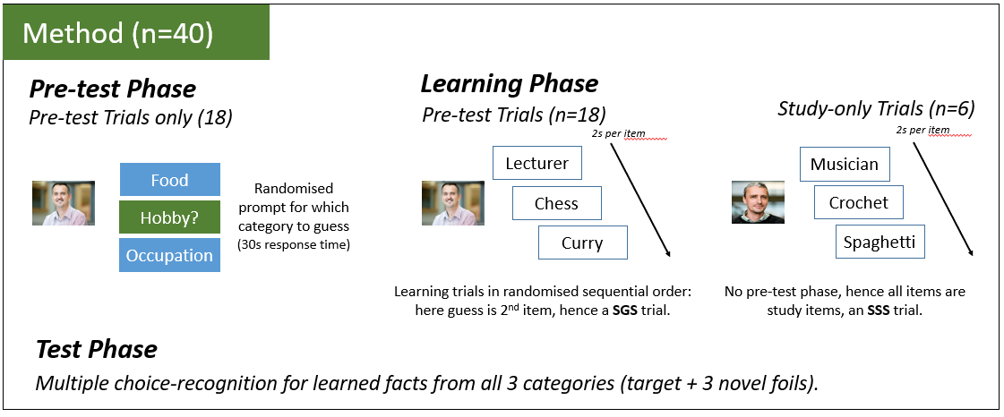
Images that provide information: Methods

Slide 57
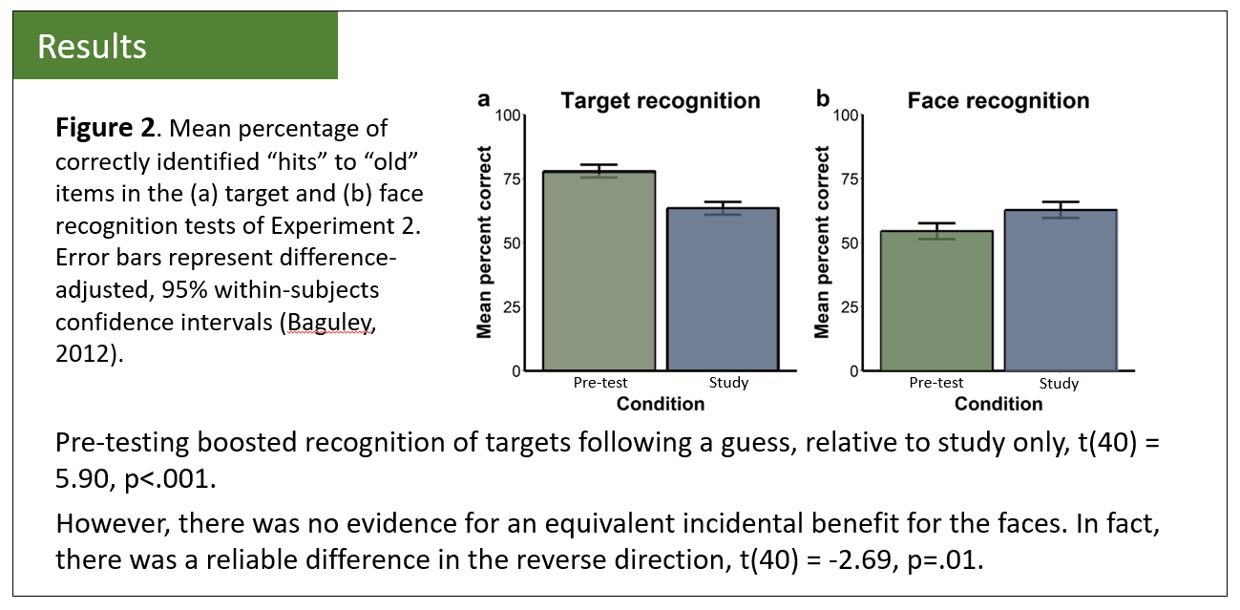
Images that provide information: Results

Slide 58
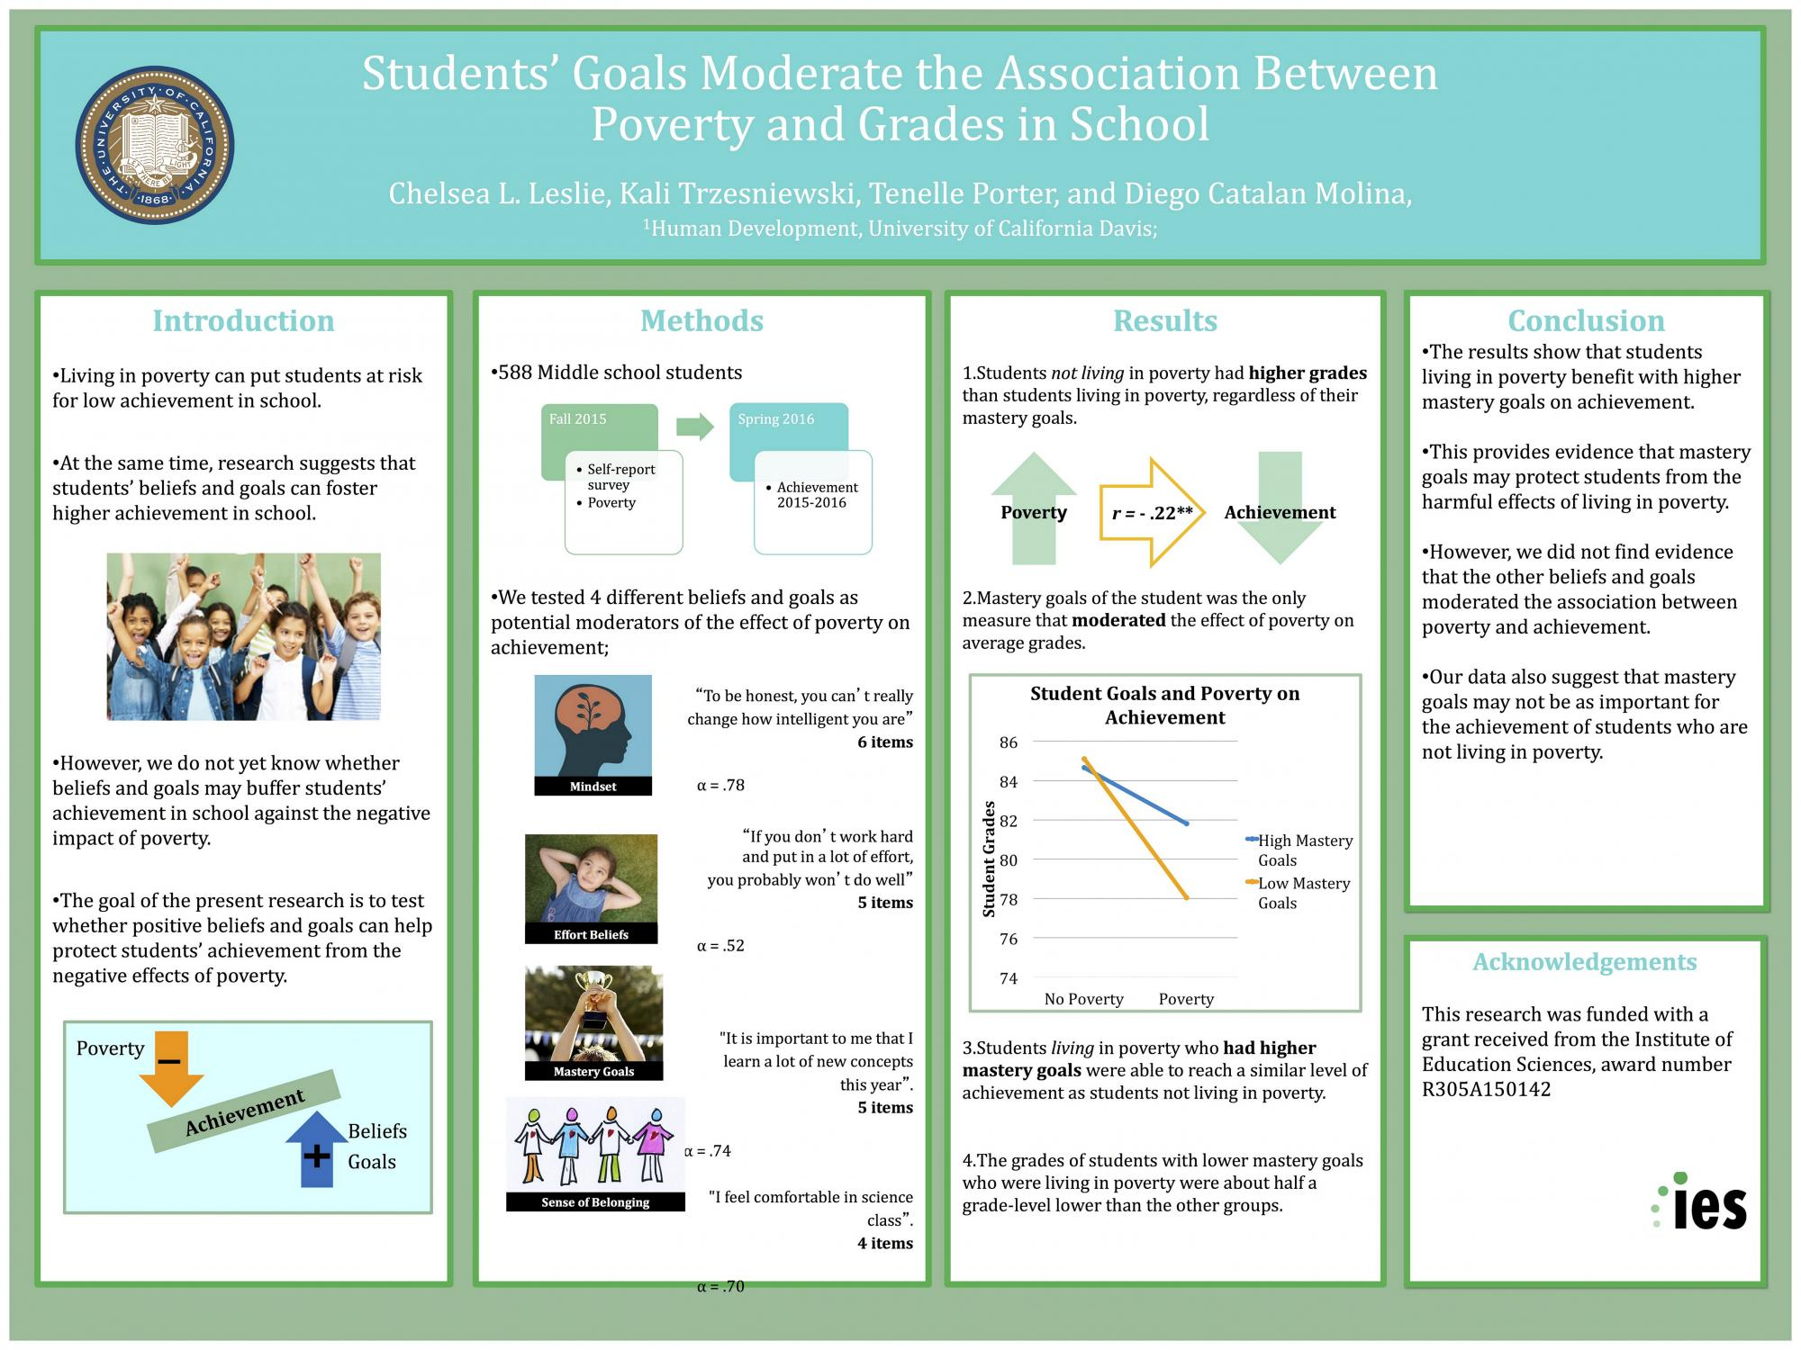
Images that increase engagement / aesthetics
These images don’t convey any information, but they do change how the poster is perceived

Slide 59
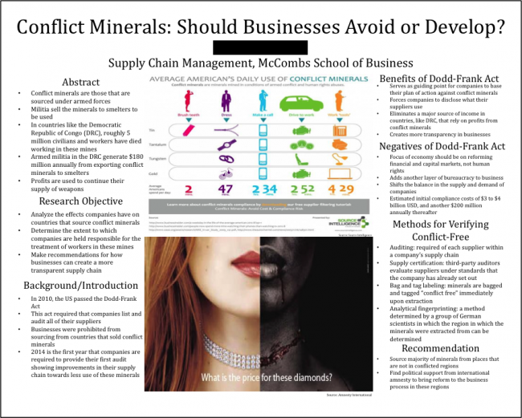
Images that increase engagement / aesthetics
Another powerful image (placed centrally for extra impact).

Slide 60
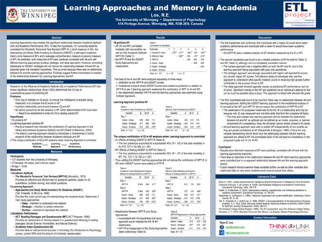
Without images…

Slide 61
4: For your poster: Images
Your poster must use images to display your findings.
A plot of the distribution of data
A plot of the means / a scatterplot.
You should also aim to use other images to
Explain the method
Increase the engagement / aesthetic appeal

Slide 62
2: Flow – how easy it is to follow a poster
Overall placement of sections
Have a scheme that is intuitively easy to follow.
If you need arrows, you have gone wrong.
Use spacing to break up sections / help the readability.

Slide 63
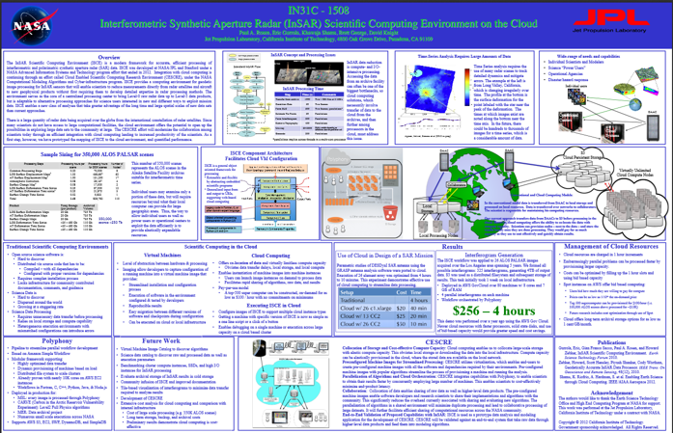
What poor flow / lack of space looks like….

Slide 64
Using space / avoid clutter: text boxes
Introduction
Guessing an answer to an unfamiliar question prior to seeing the answer leads to better memory than studying alone (the pre-testing effect), which has been attributed to increased curiosity about the answer. A similar effect occurs in general knowledge learning – people are more likely to recall answers to questions they are more curious about. Gruber and Ranganath (2019) argued that prediction errors cause a state of curiosity which improves the encoding of all information that is encountered during this state, including incidental information. If pre-testing similarly induces curiosity then it too should extend to better memory for incidental material. In our study participants guessed a categorical fact about an unfamiliar person (e.g. their hobby) before seeing the answer and two other facts (e.g. their occupation and favourite food) presented sequentially in different orders. Our prediction was that guessing should boost memory for the incidental facts only when they were presented before the answer.
Introduction
Guessing an answer to an unfamiliar question prior to seeing the answer leads to better memory than studying alone (the pre-testing effect), which has been attributed to increased curiosity about the answer. A similar effect occurs in general knowledge learning – people are more likely to recall answers to questions they are more curious about.
Gruber and Ranganath (2019) argued that prediction errors cause a state of curiosity which improves the encoding of all information that is encountered during this state, including incidental information. If pre-testing similarly induces curiosity then it too should extend to better memory for incidental material.
In our study participants guessed a categorical fact about an unfamiliar person (e.g. their hobby) before seeing the answer and two other facts (e.g. their occupation and favourite food) presented sequentially in different orders.
Our prediction was that guessing should boost memory for the incidental facts only when they were presented before the answer.

Slide 65
Highlighting key elements

Slide 66
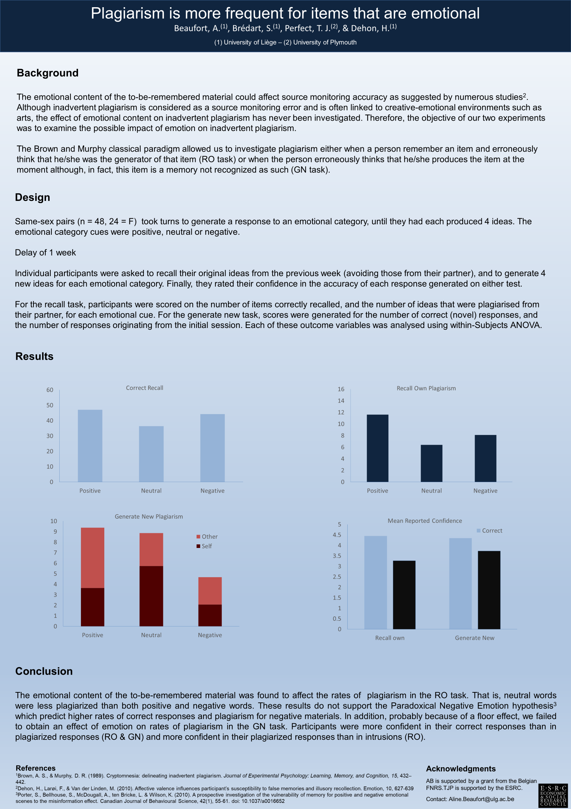
Using focal points of attention: highlighting

Slide 67
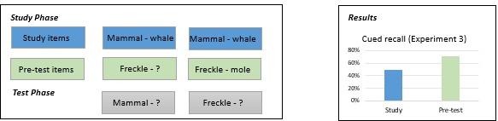
Helping the reader by linking concepts / conditions / groups

Slide 68
4: For your poster: Putting it all together
Here I have covered the content, and some of the principles behind a good scientific poster.
Your group poster will be judged on:
1: The scientific content
2: How engaging / well-designed it is.
3: How well you present it and answer questions about it.
You will learn HOW to make a poster in the workshops.

Slide 69
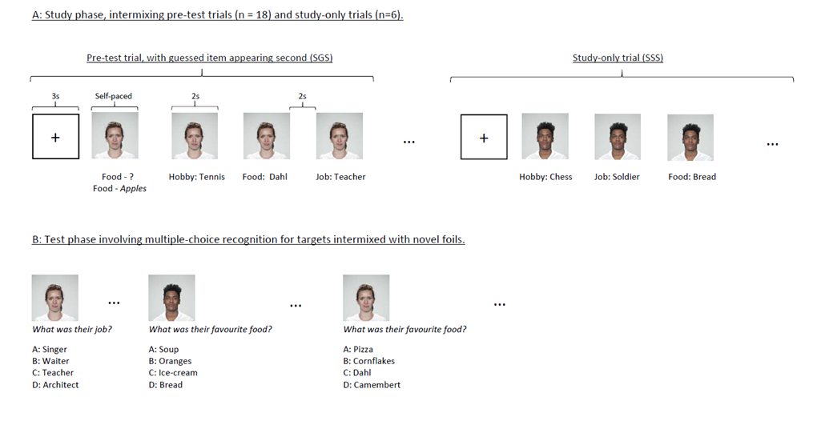
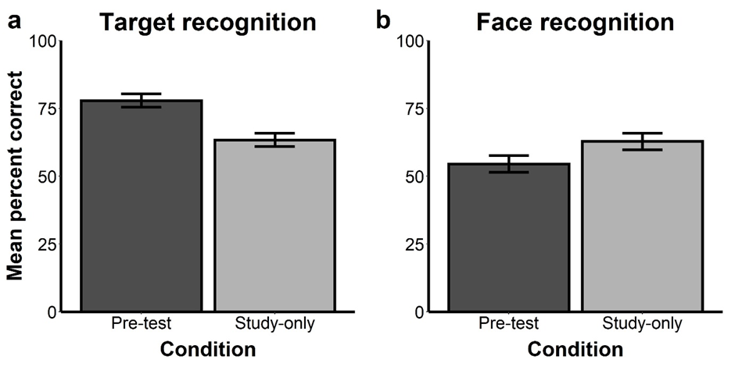

Pre-testing Effects Are Target-Specific and Are Not Driven by a Generalised State of Curiosity
Tim Hollins, Tina Seabrooke, Angus Inkster, Andy Wills & Chris Mitchell
Guessing an answer to an unfamiliar question prior to seeing the answer leads to better memory than studying alone (the pre-testing effect), which some theories attribute to increased curiosity. A similar effect occurs in general knowledge learning: people are more likely to recall information that they were initially curious to learn.
Gruber and Ranganath (2019) argued that unanswered questions can cause a state of curiosity during which encoding is enhanced for the missing answer, but also for incidental information presented at the time. If pre-testing similarly induces curiosity, then it too should produce better memory for incidental information.
We tested this idea in 3 experiments that varied the order, nature and timing of the incidental material presented within a pre-testing context. In each experiment we examined both the memory for the answer presented as feedback, and also memory for a face associated with that question.
Our hypothesis was that if curiosity drives the pre-testing effect, then guesses should be associated with better memory for the answers and the faces.
Method
Discussion
Introduction
Participants: In each experiment, we tested 32 undergraduate volunteers, who participated for course credit.
Procedure: Participants completed a series of trials, as illustrated below.
In three experiments, we demonstrated the benefits of a pre-test on subsequent recognition of the target of a guess, relative to study alone.
Experiment 1 used arbitrary facts associated with faces, while Experiments 2 and 3 used the meanings of unfamiliar rare English words. These experiments therefore add to a growing literature demonstrating that pre-testing boosts subsequent recognition memory for targets, regardless of any pre-existing semantic association (Seabrooke, Hollins et al., 2019, Seabrooke, Mitchell et al., 2019).
However, there was no evidence to suggest that the beneficial effect of guessing generalises to the incidentally presented material (faces) encountered prior to the feedback, as predicted by a curiosity-state hypothesis (Gruber & Ranganath, 2019). That is, none of our studies showed a pre-testing effect for the faces.
Results
Figure 1 shows memory performance for the target facts (a) and faces (b) in Experiment 1.
Put the details of the analysis here.
Our conclusion is therefore that the pre-testing effect is not driven by a generalised state of curiosity.
Our hypothesis was that if curiosity drives the pre-testing effect, then guesses should be associated with better memory for the answers and the faces.

